Slide 1

Web3 Security Data Analytics Externship

Slide 2
Frequence and Correlation Analysis
Frequency Analysis include checking the frequency of each risk tag and the total number of True and False tags. This gives an insight on the most occurring issues in smart contracts.
Correlation Analysis helps us understand the relationship between each risk tags and how they affect each other. Correlation less than 0.5 states that the risk tags are negatively correlated and more than 0.5 states that the risk tags are positively correlated.

Slide 3
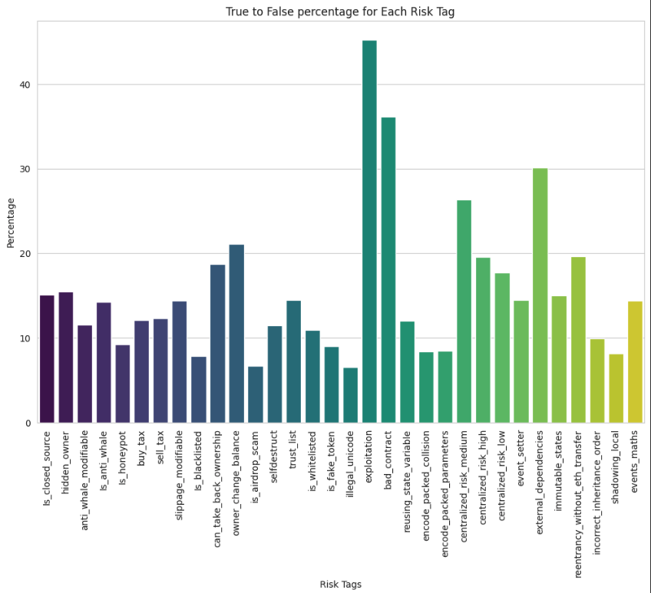
Frequency Analysis

Slide 4
The most occurring risk tags are ”exploitation” and “bad_contract”.
The 3rd most occurring risk tag is “external_dependencies” followed by “centralized_risk_medium”.
These tags shows that most of the smart contract vulnerabilities cause exploition and have moderate level control over the entire blockchain.
”external dependencies” tag indicates that most of the smart contract vulnerabilities were exploited by calling other smart contracts and using them to manipulate token prices.

Slide 5
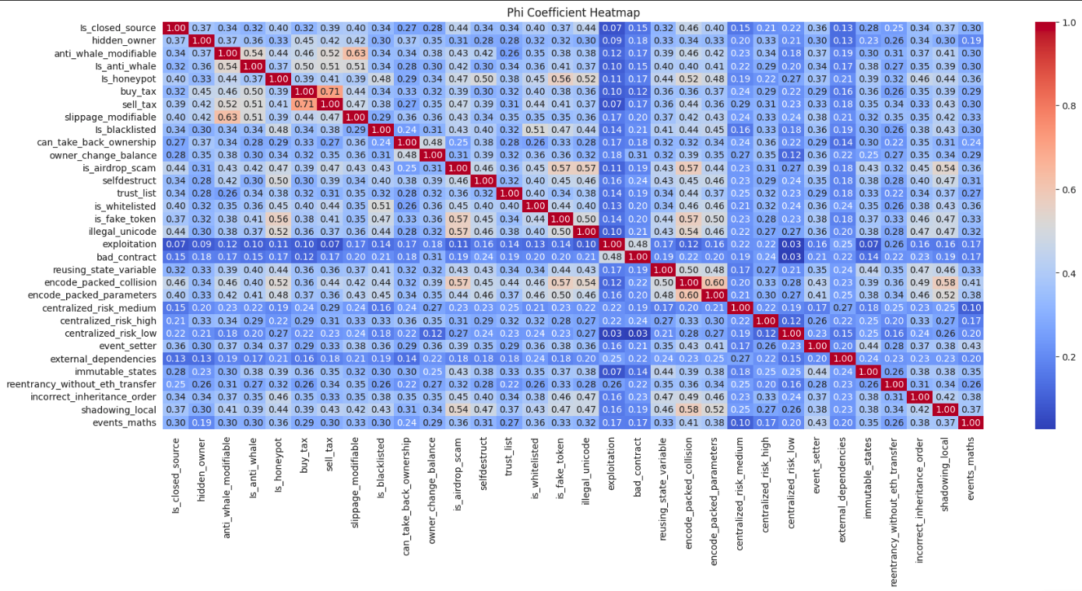
Correlation Analysis

Slide 6
The highest Phi Coefficient of correlation can be observed between “buy_tax” and “sell_tax” stating dependence of both tags on each other.
Similarly, “slippage_modifiable”-“anti_whale_modifiable” and “encode_packed_collision”-”encode_packed_parameters” show strong correlation between each other with Phi Coefficients 0.63 and 0.60 respectively.
The lowest Phi Coefficient of correlationg can be observed between “centralized_risk_low” and “exploitation / bad_contract” stating that if the low risk smart contract vulnerabilities are not related to exploitations and can easily be fixed.
“encode_packed_collision” and “reusing_state_variable” seem to have no correlation and are completely independent.

